Slide 1
Lecture 1: Data and Attributes
Mrs. Anagha Raich
Assistant Professor
KJSCE

Slide 2
Introduction to data
1.1 Understanding data, Types of attributes, Nominal, ordinal, interval, ratio, Discrete and
continuous attributes
1.2 Types of datasets: Record data, Graph-based data, Sequence data, time series data,
spatial data, General characteristics of datasets
1.3 Data quality problems, issues related to applications, Data transformations to make data
suitable for data mining, Exploratory Data Analysis vs. classical data analytics
1.4 Categorization of Data Analytics techniques, Supervised Unsupervised, semi-supervised, Application of Data science in real world: Medical and healthcare, Agriculture, disaster management etc.

Slide 3


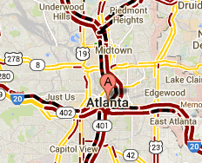
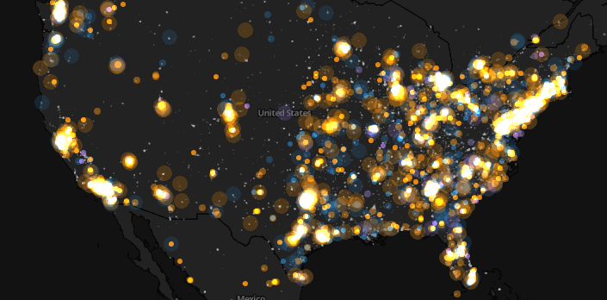
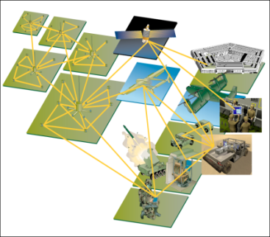
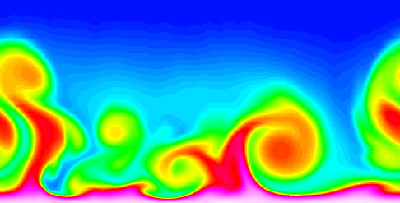
Large-scale Data is Everywhere!
There has been enormous data growth in both commercial and scientific databases due to advances in data generation and collection technologies
New mantra
Gather whatever data you can whenever and wherever possible.
Expectations
Gathered data will have value either for the purpose collected or for a purpose not envisioned.
E-Commerce
Cyber Security
Traffic Patterns
Social Networking: Twitter
Sensor Networks
Computational Simulations
Notes:
3

Slide 4
What is a data?
Data is a collection of facts. This collection can include numbers, pictures, videos, words, measurements, observations, and more.
Data analysis is the collection, transformation, and organization of data in order to draw conclusions, make predictions, and drive informed decision-making.
Data analytics can give us new information throughout data's entire life cycle.
Data science is an evolutionary extension of statistics capable of dealing with the massive amounts of data produced today. It adds methods from computer science to the repertoire of statistics.

Slide 5
Benefits and uses of data science
Data science and big data are used almost everywhere in both commercial and noncommercial Settings Commercial companies in almost every industry use data science and big data to gain insights into their customers, processes, staff, completion, and products.
Many companies use data science to offer customers a better user experience, as well as to cross-sell, up-sell, and personalize their offerings.
Governmental organizations are also aware of data’s value. Many governmental organizations not only rely on internal data scientists to discover valuable information, but also share their data with the public.
Nongovernmental organizations (NGOs) use it to raise money and defend their causes.
Universities use data science in their research but also to enhance the study experience of their students. The rise of massive open online courses (MOOC) produces a lot of data, which allows universities to study how this type of learning can complement traditional classes.

Slide 6
Facets of data
In data science and big data you’ll come across many different types of data, and each of them tends to require different tools and techniques. The main categories of data are these:
• Structured
• Unstructured
• Natural language
• Machine-generated
• Graph-based
• Audio, video, and images
• Streaming

Slide 7
Structured data
• Structured data is data that depends on a data model and resides in a fixed field within a record.
as such, it’s often easy to store structured data in tables within databases or Excel files
• SQL, or Structured Query Language, is the preferred way to manage and query data that resides
in databases.
ROLL_NO | NAME | ADDRESS | PHONE | AGE
1 | RAM | DELHI | 9455123451 | 18
2 | RAMESH | GURGAON | 9652431543 | 18
3 | SUJIT | ROHTAK | 9156253131 | 20
4 | SURESH | DELHI | 9156768971 | 18

Slide 8

Unstructured data
Unstructured data is data that isn’t easy to fit into a data model because the content is context-specific or varying. One example of unstructured data is your regular email

Slide 9
Natural language
Natural language is a special type of unstructured data; it’s challenging to process because it
requires knowledge of specific data science techniques and linguistics.
The natural language processing community has had success in entity recognition, topic recognition, summarization, text completion, and sentiment analysis, but models trained in one domain don’t generalize well to other domains.
Even state-of-the-art techniques aren’t able to decipher the meaning of every piece of text.
Machine-generated data
• Machine-generated data is information that’s automatically created by a computer, process, application, or other machine without human intervention.
• Machine-generated data is becoming a major data resource and will continue to do so. • The analysis of machine data relies on highly scalable tools, due to its high volume and speed. Examples of machine data are web server logs, call detail records, network event logs, and telemetry.

Slide 10
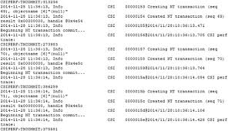

Slide 11
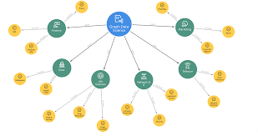
Graph-based or network data
• “Graph data” can be a confusing term because any data can be shown in a graph.
• Graph or network data is, in short, data that focuses on the relationship or adjacency of
objects.
• The graph structures use nodes, edges, and properties to represent and store graphical data. • Graph-based data is a natural way to represent social networks, and its structure allows you
to calculate specific metrics such as the influence of a person and the shortest path between
two people.

Slide 12
Audio, image, and video
• Audio, image, and video are data types that pose specific challenges to a data scientist.
• Tasks that are trivial for humans, such as recognizing objects in pictures, turn out to be
challenging for computers.
• MLBAM (Major League Baseball Advanced Media) announced in 2014 that they’ll increase video
capture to approximately 7 TB per game for the purpose of live, in-game analytics.
• Recently a company called DeepMind succeeded at creating an algorithm that’s capable of
learning how to play video games.
• This algorithm takes the video screen as input and learns to interpret everything via a complex
process of deep learning.
Streaming data
• The data flows into the system when an event happens instead of being loaded into a data store in a batch. • Examples are the “What’s trending” on Twitter, live sporting or music events, and the stock market.

Slide 13
How Data Analysis helps?
Data is everywhere. You use and create data everyday. Have you ever read reviews of a product before deciding whether or not to buy it? That's data analysis.
Or maybe you wear a fitness tracker to count your steps so you can stay active throughout the day. That's data analysis
How do you create Data and role of Data Analyst?
You also create huge amounts of it every single day.
Any time you use your phone, look up something online, stream music, shop with a credit card, post on social media or use GPS to map a route, you're creating data.
Data analyst is someone who collects, transforms, and organizes data in order to help make informed decisions

Slide 14
What is Data?
Collection of data objects and their attributes
An attribute is a property or characteristic of an object
Examples: eye color of a person, temperature, etc.
Attribute is also known as variable, field, characteristic, dimension, or feature
A collection of attributes describe an object
Object is also known as record, point, case, sample, entity, or instance
Attributes
Objects

Slide 15
Attribute Values
Attribute values are numbers or symbols assigned to an attribute for a particular object
Distinction between attributes and attribute values
Same attribute can be mapped to different attribute values
Example: height can be measured in feet or meters
Different attributes can be mapped to the same set of values
Example: Attribute values for ID and age are integers
But properties of attribute can be different than the properties of the values used to represent the attribute

Slide 16
Measurement Scales
A nominal scale classifies data into distinct categories in which no ranking is implied.
Categorical Variables Categories
Do you have a Facebook profile? Yes, No
Type of investment Growth, Value, other
Cellular Provider AT & T, sprint, Verizon, other, None

Slide 17
Measurement of Length
The way you measure an attribute may not match the attributes properties.
This scale preserves only the ordering property of length.
This scale preserves the ordering and additvity properties of length.

Slide 18
Types of Attributes
There are different types of attributes
Nominal
Examples: ID numbers, eye color, zip codes
Ordinal
Examples: rankings (e.g., taste of potato chips on a scale from 1-10), grades, height {tall, medium, short}
Interval
Examples: calendar dates, temperatures in Celsius or Fahrenheit.
Ratio
Examples: temperature in Kelvin, length, counts, elapsed time (e.g., time to run a race)

Slide 19
Types of Variable/Data
Variable
Categorical
(Qualitative)
Numerical
(Quantitative)
Names label, no order
1- Poor ,2,3,4,5 - Excellent
Measured +,-,*,/
Nominal
Ordinal
Discrete
Continuous
Marital status, Political Party, Eye Color (Defined Categories)
Ratings, Good, Better, Best, Low, Med, High (Ordered Categories)
Number of Children, Defects per Hour(counted items)
Weight, voltage (Measured characteristics)

Slide 20
Invoice Number | Customer Name | Product | Quantity | Price | Customer Satisfaction
101 | John | Laptop | 2 | 65000.5 | 5
102 | Harry | TV | 1 | 32000 | 2
Nominal
Discrete
Continuous
Ordinal

Slide 21
Properties of Attribute Values
The type of an attribute depends on which of the following properties/operations it possesses:
Distinctness: = ≠
Order: < >
Differences are + - meaningful :
Ratios are * / meaningful
Nominal attribute: distinctness
Ordinal attribute: distinctness & order
Interval attribute: distinctness, order & meaningful differences
Ratio attribute: all 4 properties/operations

Slide 22
Difference Between Ratio and Interval
Is it physically meaningful to say that a temperature of 10 ° is twice that of 5° on
the Celsius scale?
the Fahrenheit scale?
the Kelvin scale?
Consider measuring the height above average
If Bill’s height is three inches above average and Bob’s height is six inches above average, then would we say that Bob is twice as tall as Bill?
Is this situation analogous to that of temperature?

Slide 25
Lecture 2: Data and Dataset

Slide 26
Data Objects
Data sets are made up of data objects.
A data object represents an entity.
Examples:
sales database: customers, store items, sales
medical database: patients, treatments
university database: students, professors, courses
Also called samples , examples, instances, data points, objects, tuples.
Data objects are described by attributes.
Database rows -> data objects; columns ->attributes.

Slide 27
Attributes
Attribute (or dimensions, features, variables): a data field, representing a characteristic or feature of a data object.
E.g., customer _ID, name, address
Types:
Nominal
Binary
Ordinal
Numeric: quantitative
Interval-scaled
Ratio-scaled

Slide 28
Attribute Types
Nominal: categories, states, or “names of things”, do not have any meaningful order, enumeration
Hair_color = {auburn, black, blond, brown, grey, red, white}
marital status, occupation = Not =
Binary
Nominal attribute with only 2 states (0 and 1)
Symmetric binary: both outcomes equally important, have same weight
e.g., gender
Asymmetric binary: outcomes not equally important.
e.g., medical test (positive vs. negative)
Convention: assign 1 to most important outcome (e.g., HIV positive)
Ordinal
Values have a meaningful order (ranking) but magnitude between successive values is not known. < >
Size = {small, medium, large}, grades{A,B,C,D}, army rankings

Slide 29
Numeric Attribute Types
Quantity (integer or real-valued)
Interval
Measured on a scale of equal-sized units
Values have order + -
E.g., temperature in C˚or F˚, calendar dates
No true zero-point
Can compare and quantify
Numeric in nature
Measures of central tendency(mean, median, mode)
Ratio
Inherent zero-point
We can speak of values as being an order of magnitude larger than the unit of measurement (10 K˚ is twice as high as 5 K˚).
e.g., temperature in Kelvin, length, counts, monetary quantities

Slide 30
Discrete vs. Continuous Attributes
Attributes ML point of view
Discrete Attribute
Has only a finite or countably infinite(one to one correspondence with natural number)set of values
E.g., zip codes, profession, or the set of words in a collection of documents
Sometimes, represented as integer variables
Note: Binary attributes are a special case of discrete attributes
Continuous Attribute
Has real numbers as attribute values
E.g., temperature, height, or weight
Practically, real values can only be measured and represented using a finite number of digits
Continuous attributes are typically represented as floating-point variables

Slide 31
Asymmetric Attributes
Only presence (a non-zero attribute value) is regarded as important
Words present in documents
Items present in customer transactions
If we met a friend in the grocery store would we ever say the following? “I see our purchases are very similar since we didn’t buy most of the same things.”

Slide 32
Critiques of the attribute categorization
Incomplete
Asymmetric binary
Cyclical
Multivariate
Partially ordered
Partial membership
Relationships between the data
Real data is approximate and noisy
This can complicate recognition of the proper attribute type
Treating one attribute type as another may be approximately correct

Slide 33
Key Messages for Attribute Types
The types of operations you choose should be “meaningful” for the type of data you have
Distinctness, order, meaningful intervals, and meaningful ratios are only four (among many possible) properties of data
The data type you see – often numbers or strings – may not capture all the properties or may suggest properties that are not present
Analysis may depend on these other properties of the data
Many statistical analyses depend only on the distribution
In the end, what is meaningful can be specific to domain

Slide 34
Important Characteristics of Data
Dimensionality (number of attributes)
High dimensional data brings a number of challenges
Sparsity
Only presence counts.
Skew data
Non zero values are important
Resolution
Patterns depend on the scale
Size
Type of analysis may depend on size of data

Slide 35
Lecture 3: Types of Dataset
Mrs. Anagha Raich
Assistant Professor
KJSCE

Slide 36
Review General characteristics of Data Sets
Dimensionality, Sparsity, and Resolution.
Dimensionality of a data
The dimensionality of a data set is the number of attributes that the objects in the data set have.
In a particular data set if there are high number of attributes (also called high dimensionality), then it can become difficult to analyse such a data set. When this problem is faced, it is referred to as Curse of Dimensionality.
In order to understand what the hell is this Curse of Dimensionality, we first need to understand the other two characteristics of Data.

Slide 37
Sparsity
For some data sets, such as those with asymmetric features, most attributes of an object have values of 0; in many cases fewer than 1% of the entries are non-zero. Such a data is called sparse data or it can be said that the data set has Sparsity.

Slide 38
Resolution
The patterns in the data depend on the level of resolution. If the resolution is too fine, a pattern may not be visible or may be buried in noise; if the resolution is too coarse, the pattern may disappear. For example, variations in atmospheric pressure on a scale of hours reflect the movement of storms and other weather systems. On a scale of months, such phenomena are not detectable

Slide 39
Curse of Dimensionality
Many types of Data Analysis becomes difficult as the dimensionality (number of attributes in the data set) of the data set increases.
Specifically, as dimensionality increases, the data becomes increasingly sparse in the space that it occupies.
For classification, this can mean that there are not enough data objects to allow the creation of a model that reliably assigns a class to all possible objects.
For clustering, the definitions of density and the distance between points, which are critical for clustering, become less meaningful.

Slide 40
Data sets
A Data set is a set or collection of data.
This set is normally presented in a tabular pattern.
Every column describes a particular variable.
And each row corresponds to a given member of the data set, as per the given question.
This is a part of data management

Slide 41
Types of data sets in Data Mining Domain
Record
Data Matrix
Document Data
Transaction Data
Graph
World Wide Web
Molecular Structures
Ordered
Spatial Data
Temporal Data
Sequential Data
Genetic Sequence Data

Slide 42
Record Data
Data that consists of a collection of records, each of which consists of a fixed set of attributes

Slide 43
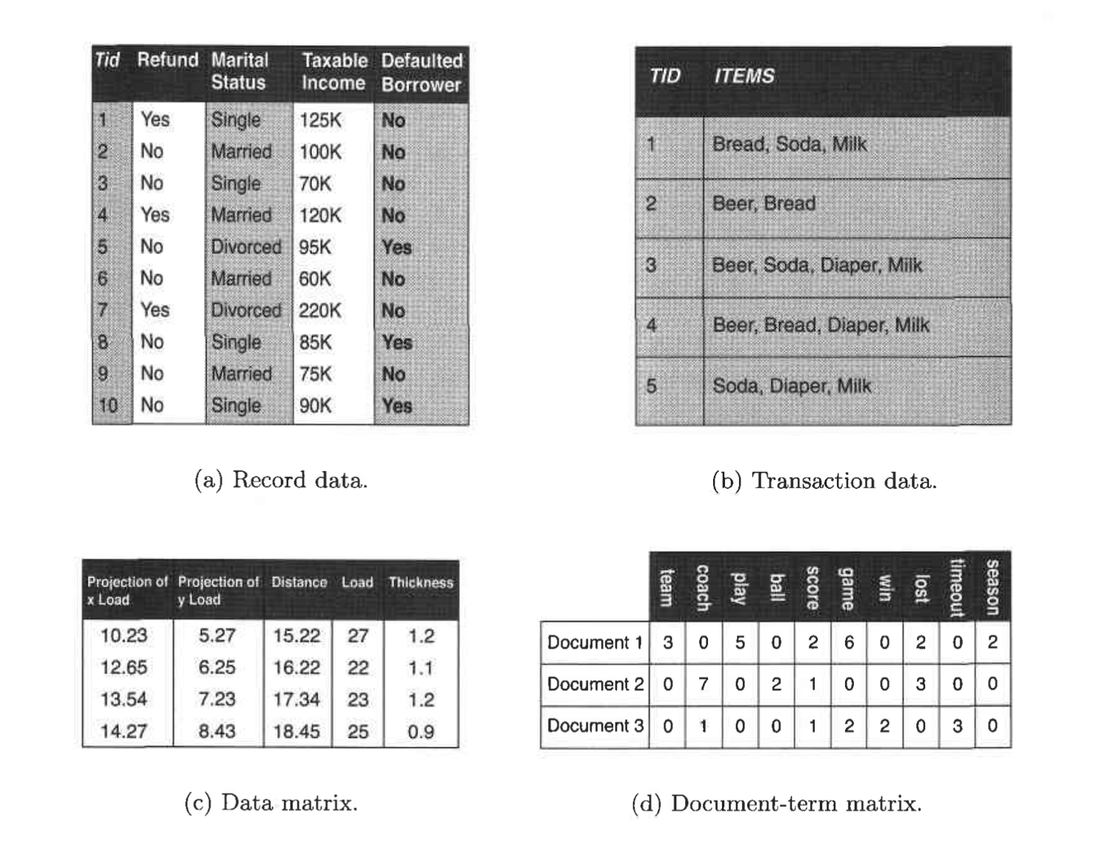

Slide 44
Record Data
Transaction data- Record data→Market basket data
Market basket data because the items in each record are the product in persons market basket.

Slide 45
Transaction or Market Basket Data
It is a special type of record data, in which each record contains a set of items. For example, shopping in a supermarket or a grocery store. For any particular customer, a record will contain a set of items purchased by the customer in that respective visit to the supermarket or the grocery store. This type of data is called Market Basket Data. Transaction data is a collection of sets of items, but it can be viewed as a set of records whose fields are asymmetric attributes. Most often, the attributes are binary, indicating whether or not an item was purchased or not.

Slide 46
Data Matrix (pattern matrix)
If data objects have the same fixed set of numeric attributes, then the data objects can be thought of as points in a multi-dimensional space, where each dimension represents a distinct attribute
Such a data set can be represented by an m by n matrix, where there are m rows, one for each object, and n columns, one for each attribute

Slide 47
Document Data
Each document becomes a ‘term’ vector
Each term is a component (attribute) of the vector
The value of each component is the number of times the corresponding term occurs in the document.

Slide 48
Transaction Data
A special type of data, where
Each transaction involves a set of items.
For example, consider a grocery store. The set of products purchased by a customer during one shopping trip constitute a transaction, while the individual products that were purchased are the items.
Can represent transaction data as record data

Slide 49
Graph Data : Molecular(Data with Objects)
Examples: Generic graph, a molecule, and webpages : Graph Mining : Analyze Graph Data
Benzene Molecule: C6H6

Slide 50
WWW dataset:
Text and link other page
Search Queries on WWW: we collect web pages and process web pages and extract data.

Slide 51
Summarized
Revise Characteristics of data and watch imp. Curse of Dimensionality
Data Set meaning
Exploring Statistical types of datasets: univariate ,multivariate…
Data Mining Datasets:
1. Record Data :Flat File(RDBMS), Transaction Data(Market Basket Transaction Data),Data Matrix(Pattern Matrix), Document Data (e.g. Marksheet of students),sparse Matrix
2. Graph Dataset: WWW dataset : Data and link
Molecular Dataset: Relationship among object(Web
Mining)

Slide 52
Lecture 4 Ordered Data and Data Quality

Slide 53
Last week Revision
Data:
Attributes of Data-Qualitative(Categorical)and Quantitative(Numeric)
Datasets- Dimensionality-curse of dimensionality-sparsity , resolution
Types of data sets-Record Data(Transaction ,document, sparse,Matrix)
Graph based data-WWW and molecular data

Slide 54
Ordered Data
For some types of data, the attributes have relationships that involve order in time or space. This data can be segregated into four types:
Sequential Data
Sequence Data
Time Series Data
Spatial Data

Slide 55
Sequential Data(Sequential Transaction Data)
Also referred to as temporal data.
It can be thought of as an extension of record data,
where each record has a time associated with it.
Example :
Consider a retail transaction data set that also stores the time at which the transaction took place

Slide 56
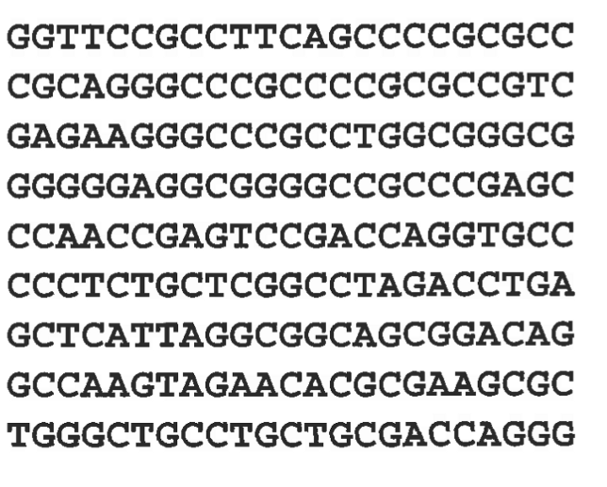
Sequence Data(e.g. Genomic Sequence data)
Sequence data consists of a data set that is a sequence of individual entities, such as a sequence of words or letters.
It is quite similar to sequential data, except that there are no time stamps; instead, there are positions in an ordered sequence.
For example, the genetic information of plants and animals can be represented in the form of sequences of nucleotides that are known as genes.

Slide 57
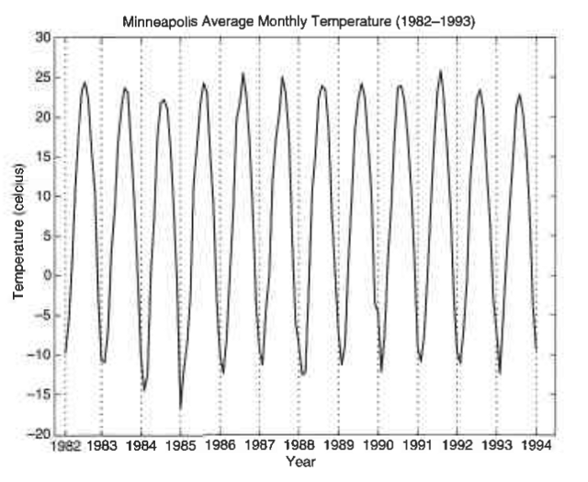
Time Series Data
Its a special type of sequential data .
Record is a time series, i.e., a series of measurements taken over time.
For example: a financial data set might contain objects that are time series of the daily prices of various stocks.

Slide 58
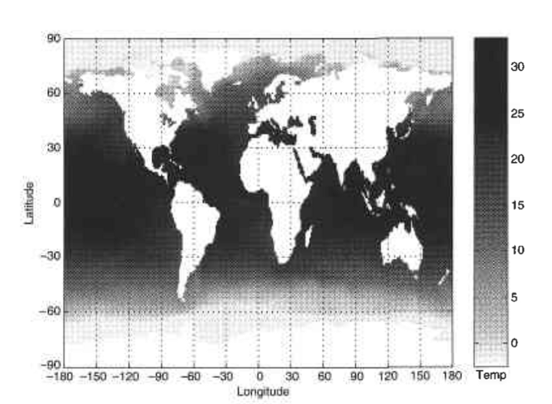
Spatial Data
Some objects have spatial attributes, such as positions or areas, as well as other types of attributes.
An example of spatial data is weather data (precipitation, temperature, pressure) that is collected for a variety of geographical locations.

Slide 59
Non Record Based Data
Example Benzene Ring-Substructure of atoms/molecules
Not Capture all the information in the data
Such data –data matrix where rows-locations and columns time

Slide 60
Data Quality
It refers to the ability of a data set to serve whichever need a company hopes to use it for.
That need
could be sending marketing materials to customers.
could be studying the market to plan a new product feature.
Could be maintaining a database of customer data for help with product support services
Could any number of other goals.
No matter what the exact use case for your data, data quality is important.
Without it, the data can’t fulfill its intended purpose.
Errors within a database of addresses would prevent you from using the data to reach customers effectively.
A database of phone numbers that doesn’t always include area codes for each entry falls short of providing the information you need to put the data to use in many situations.

Slide 61
Common causes of data quality problems
Manual Entry
OCR errors
Lack of complete information
Ambiguous data
Duplicate data
Data transformation errors

Slide 62
Common Errors
1. Manual data entry errors
Humans are prone to making errors, and even a small data set that includes data entered manually by humans is likely to contain mistakes. Data entry errors such as typos, data entered in the wrong field, missed entries, and so on are virtually inevitable.
2. OCR errors
Machines can make mistakes when entering data, too. In cases where organizations must digitize large amounts of data quickly, they often rely on Optical Character Recognition, or OCR, technology to do so. OCR technology scans images and extracts text from them automatically. It can be very useful when, for example, you want to take thousands of addresses that are printed on paper and enter them into a digital database so you can analyze them. The problem with OCR is that it is almost always imperfect.
If you’re OCR’ing thousands of lines of text, you’re almost certainly going to have some characters or words that are misinterpreted – zeroes that are interpreted as eights, for example, or proper nouns that are read as common words because the OCR tool fails to distinguish properly between capital and lowercase letters. The same sorts of issues arise with other types of automated machine entry of data, such as text-to-speech

Slide 63
Common Errors
3. Lack of complete information
When compiling a data set, you frequently run into the problem of not having all information available for every entry.
For example, a database of addresses may be missing the zip codes for some entries because the zip codes couldn’t be determined via the method that was used to compile the dataset.
4. Ambiguous data
When building a database, you may find that some of your data is ambiguous, leading to uncertainty about whether, how and where to enter it.
For example, if you are creating a database of phone numbers, some of the numbers you seek to enter may be longer than the typical ten digits that you have in a United States phone number. Are those longer numbers simply typos, or are they international phone numbers that include more digits? In the latter case, does the number contain complete international dialing information?
These are the sorts of questions that are hard to answer quickly and systematically when you’re working with a large body of data.

Slide 64
Common Error
5. Duplicate data
You may find that two or more data entries are mostly or completely identical.
For example, maybe your database contains two entries for a John Smith living at 123 Main St. Based on this information, it’s difficult to know whether these entries are simply duplicates (maybe John Smith’s information was entered twice by mistake) or if there are two John Smiths (a father and son, perhaps) living at the same address. You need to sort out seemingly duplicate entries like this to make the best use of your data.
6. Data transformation errors
Converting data from one format to another can lead to mistakes.
As a simple example, you may have a spreadsheet that you convert to a comma-separated value, or CSV file. Because data fields inside CSV files are separated by commas, you may run into issues when performing this conversion in the event that some of the data entries in your spreadsheet contain commas inside them.
Unless your data conversion tools are sufficiently smart, they won’t know the difference between a comma that is supposed to separate two data fields and one that is an internal part of a data entry. This is a basic example; things get much more complicated when you must perform complex data conversions, such as taking a mainframe database that was designed decades ago and converting it to NoSQL, a category of database that has become popular in just the last few years.

Slide 65
Problems Data Quality
Poor data quality negatively affects many data processing efforts
Data mining example: a classification model for detecting people who are loan risks is built using poor data
Some credit-worthy candidates are denied loans
More loans are given to individuals that default

Slide 66
Data Quality Problems …
What kinds of data quality problems?
How can we detect problems with the data?
What can we do about these problems?
Examples of data quality problems:
Noise and outliers
Wrong data
Fake data
Missing values
Duplicate data

Slide 67
Noise
For objects, noise is an extraneous object
For attributes, noise refers to modification of original values
Examples: distortion of a person’s voice when talking on a poor phone and “snow” on television screen
The figures below show two sine waves of the same magnitude and different frequencies, the waves combined, and the two sine waves with random noise
The magnitude and shape of the original signal is distorted

Slide 68

Outliers
Outliers are data objects with characteristics that are considerably different than most of the other data objects in the data set
Case 1: Outliers are noise that interferes with data analysis
Case 2: Outliers are the goal of our analysis
Credit card fraud
Intrusion detection
Causes?

Slide 69
Missing Values
Reasons for missing values
Information is not collected (e.g., people decline to give their age and weight)
Attributes may not be applicable to all cases (e.g., annual income is not applicable to children)
Handling missing values
Eliminate data objects or variables
Estimate missing values
Example: time series of temperature
Example: census results
Ignore the missing value during analysis

Slide 70
Duplicate Data
Data set may include data objects that are duplicates, or almost duplicates of one another
Major issue when merging data from heterogeneous sources
Examples:
Same person with multiple email addresses
Data cleaning
Process of dealing with duplicate data issues
When should duplicate data not be removed?

Slide 71
Summary
Ordered Data
Data Quality
Causes of Data Quality?
What is the problem with data Quality?

